Slide 1



Amazon Sales Analysis
Sales analysis involves evaluating sales data to understand trends, patterns, and performance. It helps businesses identify strengths and weaknesses in their sales strategies, uncover opportunities for growth, and make informed decisions.
By Sudipta Mahato​

Slide 2

Problem Statement
Sales management has gained importance to meet increasing competition and the need for improved methods of distribution to reduce cost and to increase profits. Sales management today is the most important function in a commercial and business enterprise.

Slide 3
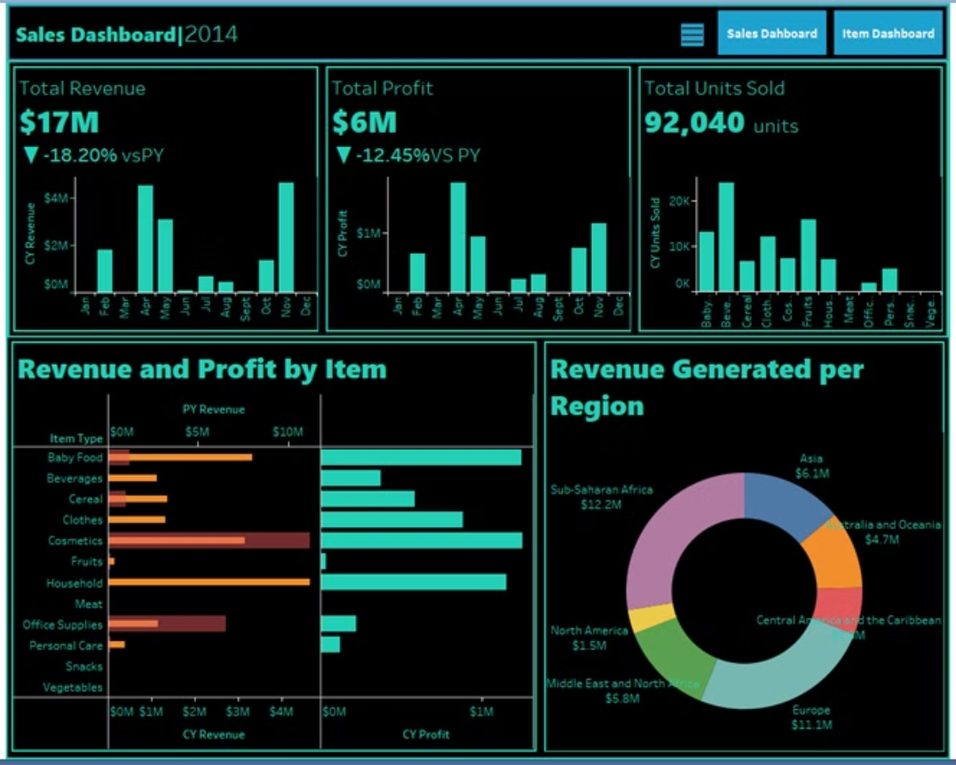
Dashboard

Slide 4
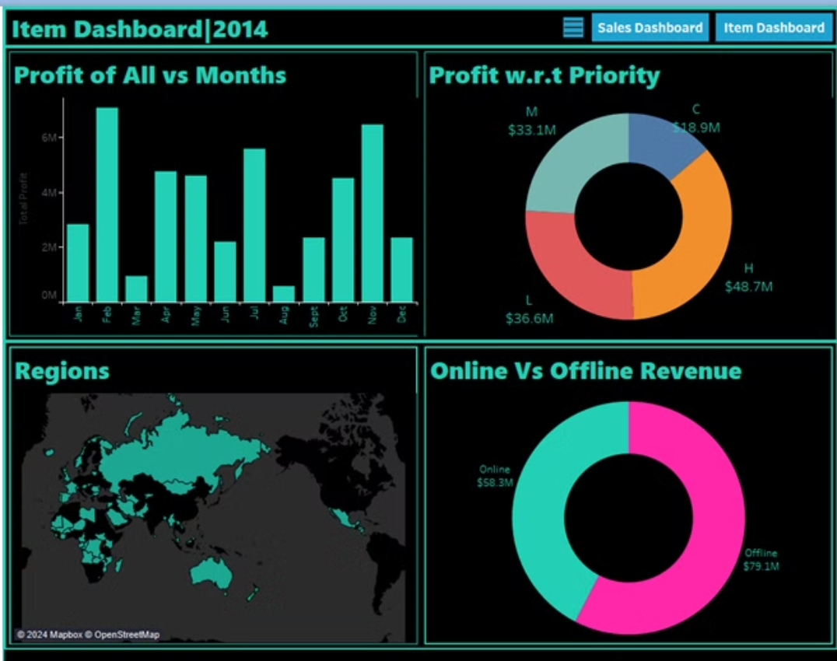
Dashboard

Slide 5
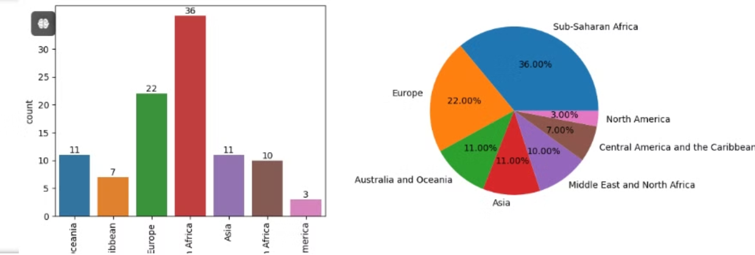
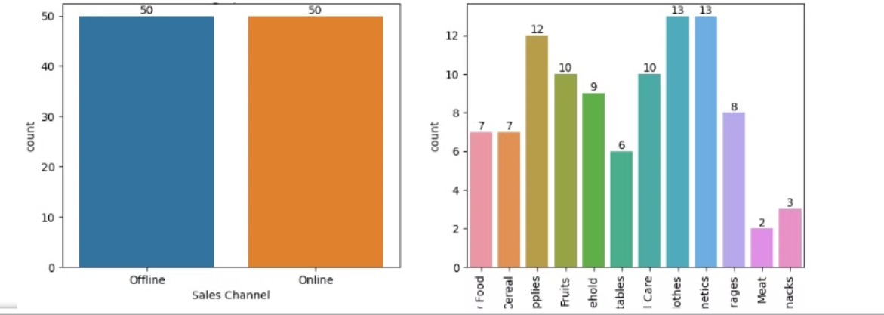
Insights

Slide 6
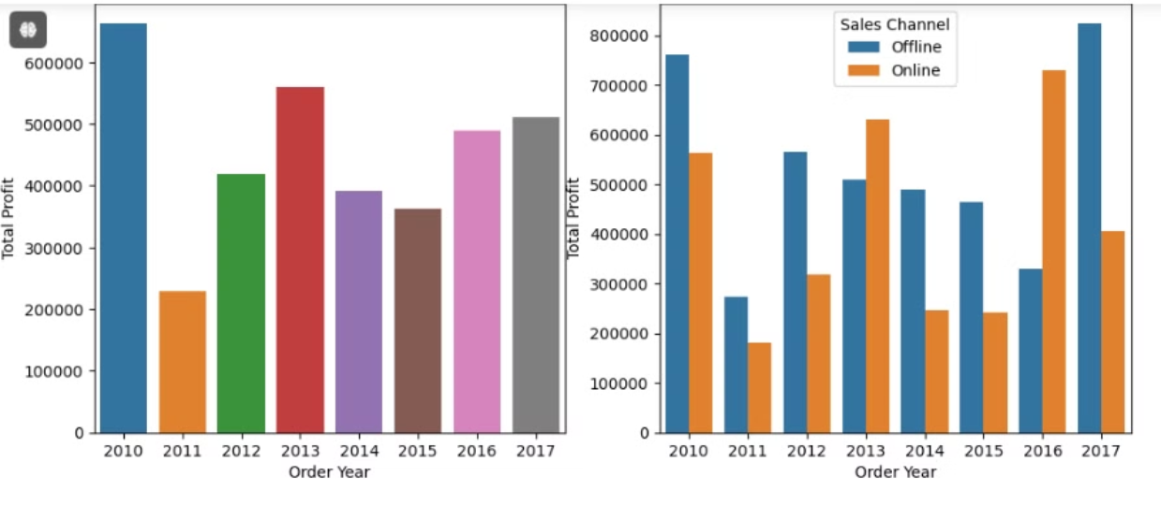
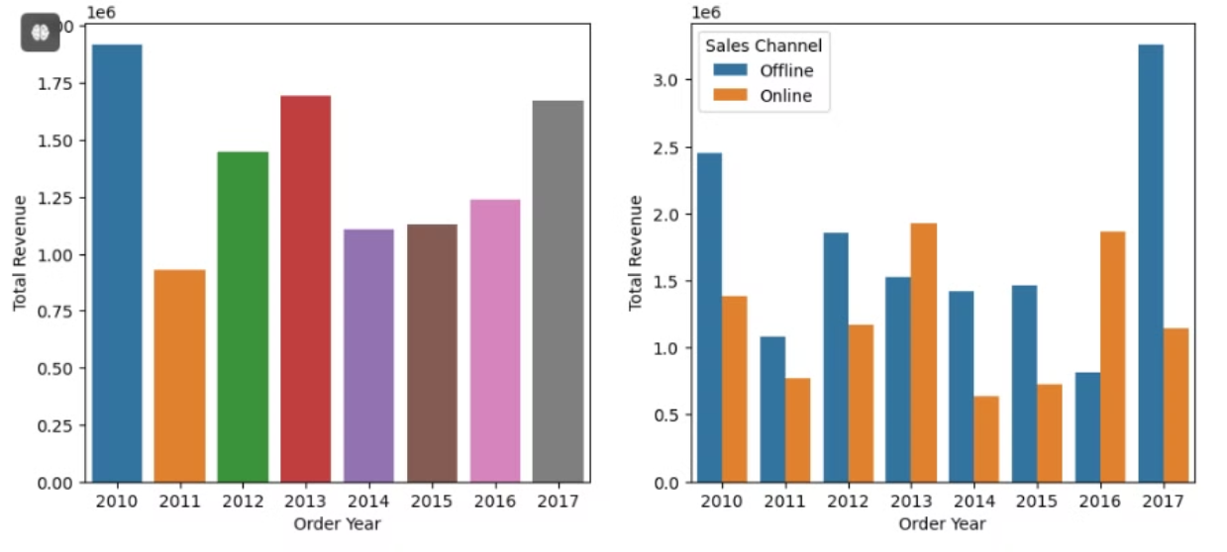
Insights

Slide 7
Insights
MOST OF THE SALES TOOK PLACE IN SUB-SAHARAN AFRICAN,EUROPEAN REGION NEARLY 36% AND 22% RESPECTIVELY.
MAJORITY OF THE ITEMS SOLD ARE OF THE TYPE CLOTHES,COSMETICS AND OFFICE SUPPLIES
THERE IS EQUAL NUMBER IN OFFLINE AS WELL AS ONLINE CHANNEL
MOST REVENUE AND PROFIT IS GENERATED FROM THE SUB-SAHARAN AFRICAN REGION.
MOST OF THE REVENUE AND PROFIT IS GENERATED ON THE ITEMS OF COSMETICS,HOUSEHOLD,OFFICE SUPPLIES.
MOST OF THE REVENUE AND PROFIT IS GENERATED FROM OFFLINE SALES CHANNEL AS COMPARED TO ONLINE

Slide 8
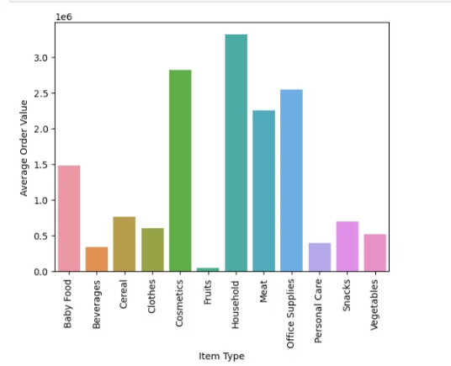
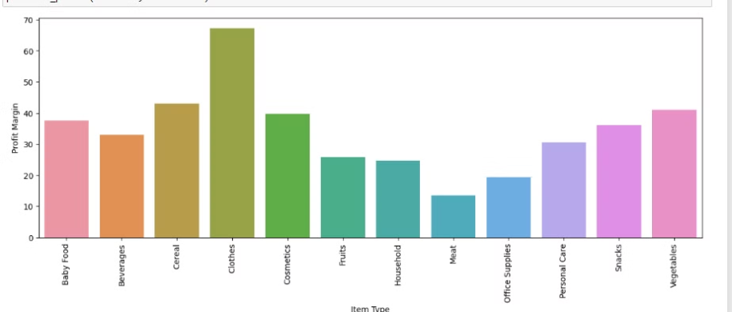
Insights
The Average Order Value (AOV) is highest for household items, followed by cosmetics, office supplies, and meat. Therefore, we should stock up on these items more.
Most profit margin is earned by the sale of clothes, and the lowest profit margin is from the sale of meat.

Slide 9
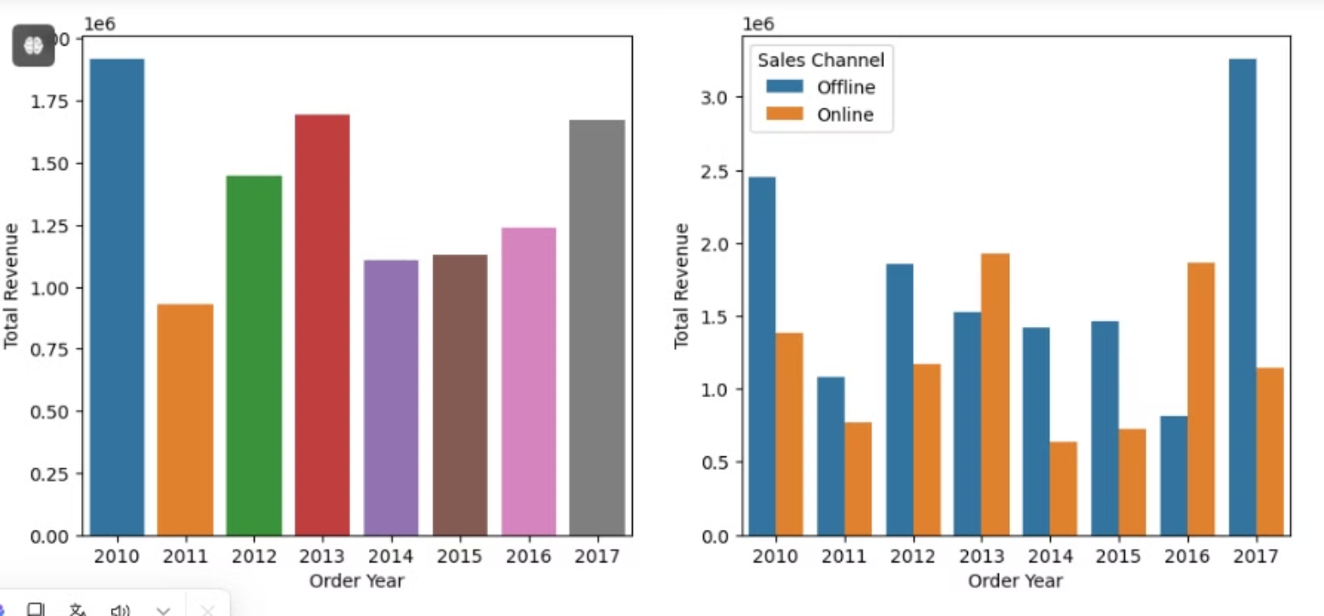
Insights
Most of the Revenue is generated in the year 2010.

Slide 10


Thank You

